Slide 1
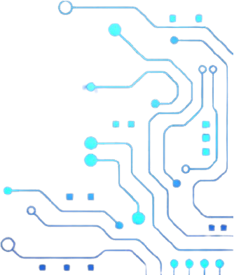

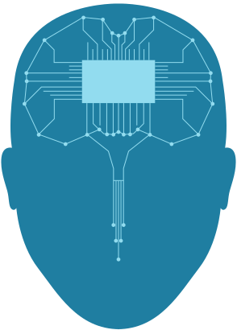




DISASTER MANAGEMENT MOBILE APP
pitch deck by :
Group 18

Slide 2
TABLE OF CONTENT
01
Introduction
02
System modelling
03
04
System design
Conclusion

Slide 3
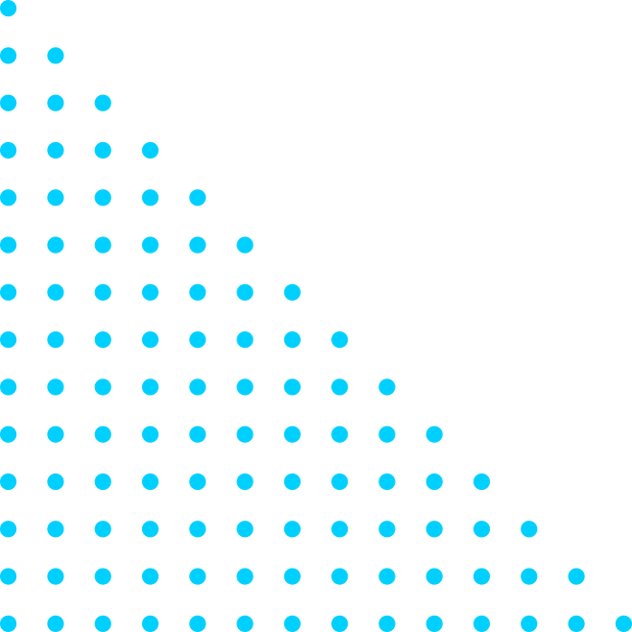
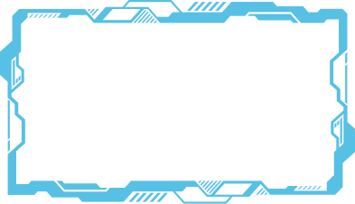
INTRODUCTION
Developing a disaster management mobile application requires careful consideration of system modeling and design principles to ensure it is effective, reliable, and user-friendly. By leveraging modern technologies and adhering to best practices in system modeling and design, the application can significantly contribute to disaster preparedness, response, and recovery efforts.

Slide 4
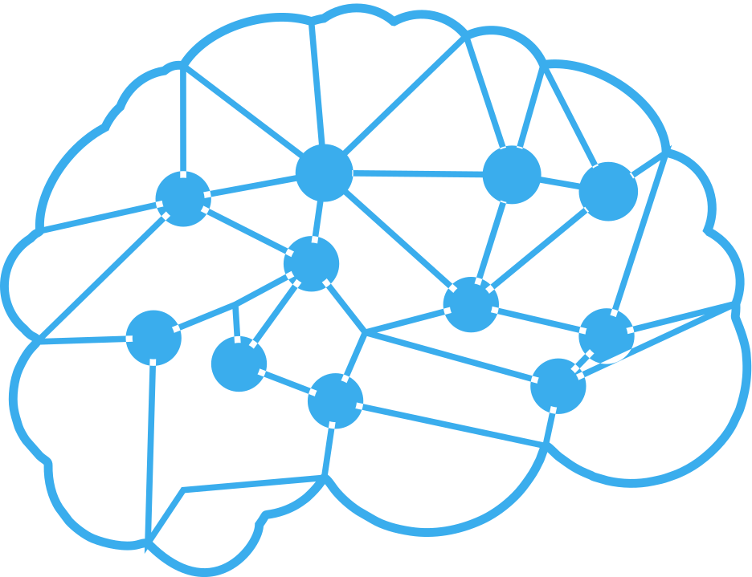
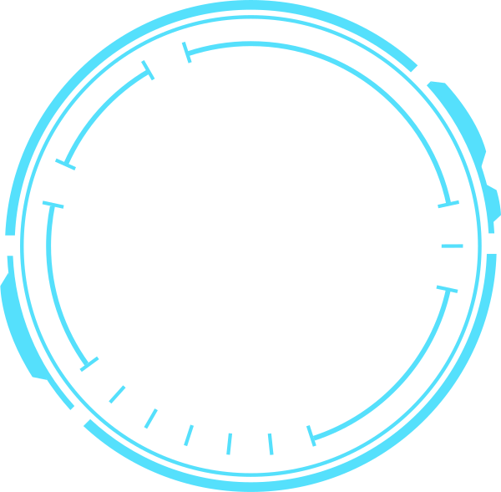

System Modelling
01
System modeling involves creating abstract representations of a system to understand and analyze its structure and behavior.
Context
Usecase
Sequence
Class
Deployment

Slide 5
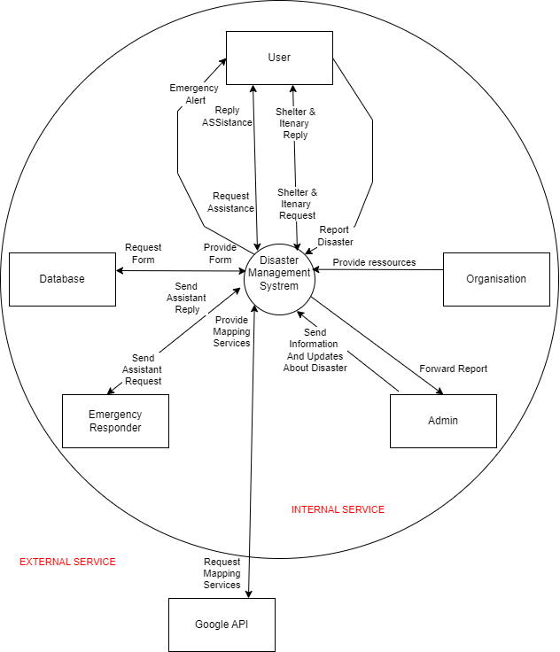
1, CONTEXT
A Context Diagram is a high-level, visual representation of a system that shows the system as a single process and its interaction with external entities. It provides an overview of the system's boundary, its interactions with external entities, and the flow of information between them.

Slide 6
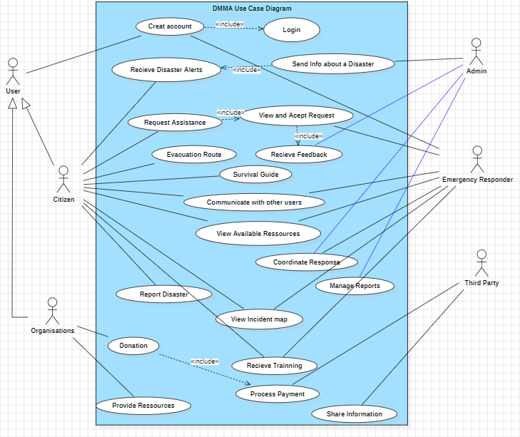
2, USE CASE
A Use Case Diagram is a type of diagram defined by the Unified Modeling Language (UML) that represents the functional requirements of a system. It illustrates the interactions between the system and its external entities (actors), showing the system’s functionalities (use cases) from a user’s perspective.

Slide 7
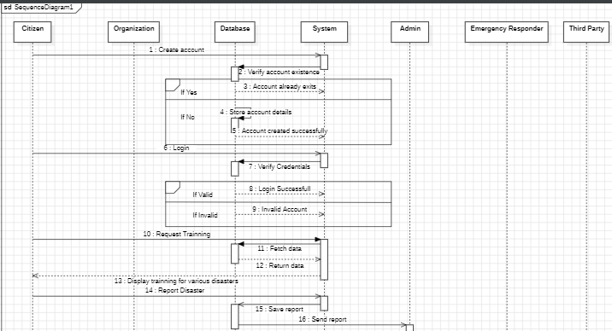
3, SEQUENCE
A Sequence Diagram is a type of interaction diagram in the Unified Modeling Language (UML) that shows how objects interact with each other and in what order.

Slide 8
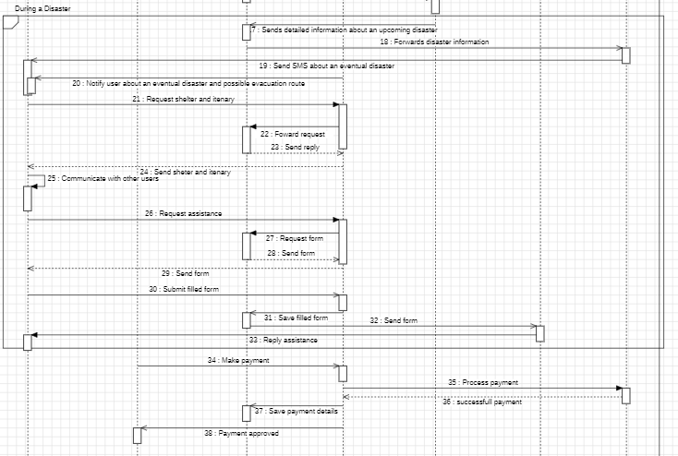
3, SEQUENCE
A Sequence Diagram is a type of interaction diagram in the Unified Modeling Language (UML) that shows how objects interact with each other and in what order.

Slide 9
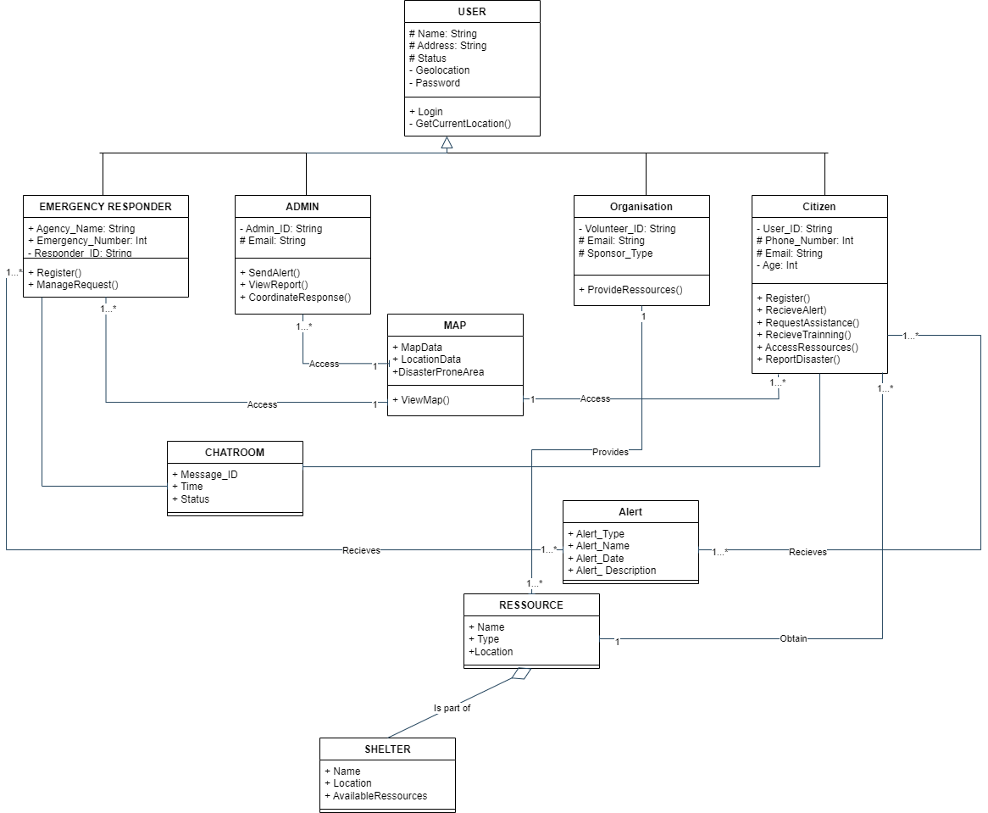
4, CLASS
A Class Diagram is a type of static structure diagram in the Unified Modeling Language (UML) that describes the structure of a system by showing its classes, their attributes, methods, and the relationships among the objects.

Slide 10
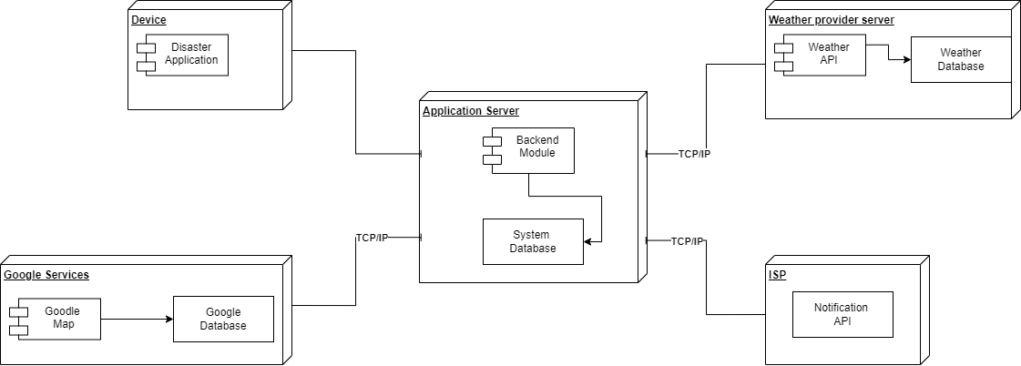
5, DEPLOYMENT
A Deployment Diagram is a type of diagram in the Unified Modeling Language (UML) that models the physical deployment of artifacts (software or system components) on nodes (hardware or server components).

Slide 11
System DESIGN
2
System design is the process of defining the architecture, components, modules, interfaces, and data for a system to satisfy specified requirements. It involves translating the logical design of a system into a physical blueprint, which includes both hardware and software specifications. The goal of system design is to create a blueprint that provides the functionality, performance, and scalability required by the system's stakeholders.

Slide 12

HYBRID ARCHITECTURE
Client Layer
Backend Layer
Developed using React Native or Flutter to ensure cross-platform compatibility, Features include user login, disaster reporting, assistance requests, and resource location.
ntegrating cloud-based services with traditional server-based components to ensure scalability, reliability, and efficiency
HYBRID
Integration Layer
Security Layer
involves addressing multiple aspects of security, including data protection, secure communication, authentication, and authorization
The integration layer ensures seamless communication and data exchange between various components, external systems, and services.

Slide 13
CONCLUSION
The UML diagrams and the hybrid architecture provide a comprehensive blueprint for developing a disaster management mobile application. By following this structured approach, we are well-positioned to develop a disaster management mobile application that significantly enhances disaster response and management capabilities, ultimately saving lives and improving resilience in disaster-prone areas.

Slide 14
Thanks!

